Slide 2
Day of Exam with CLC Student Login & Exam Process

Slide 3
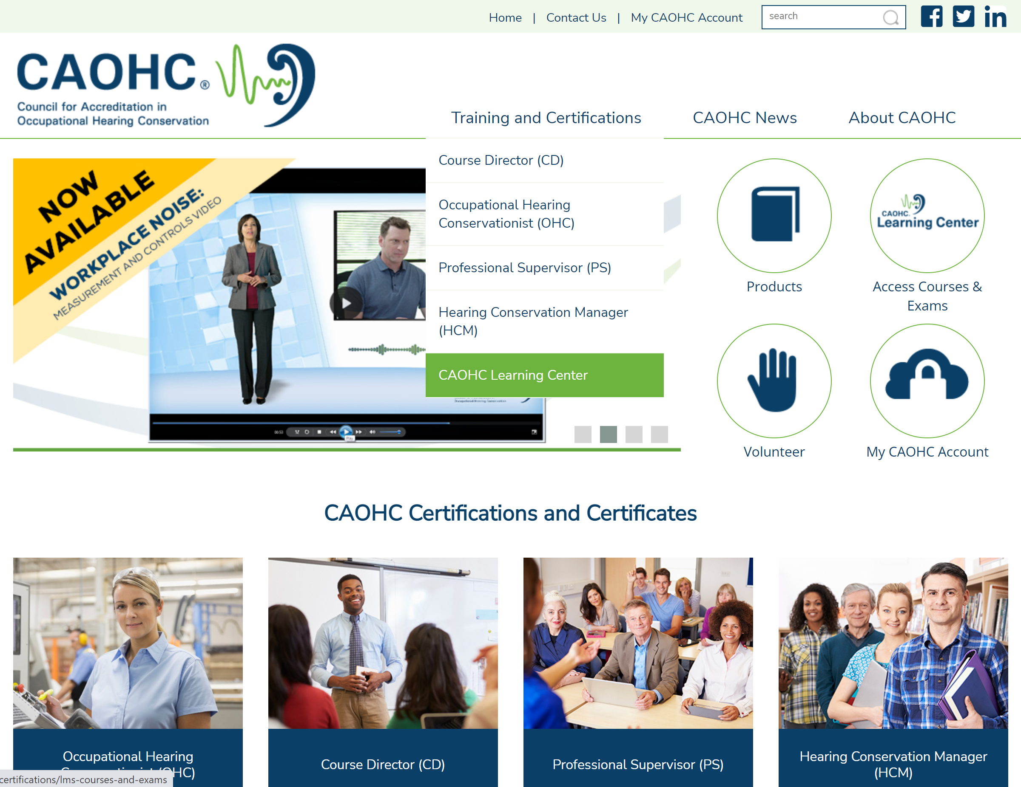
CLC – Student Login
OR

Slide 4
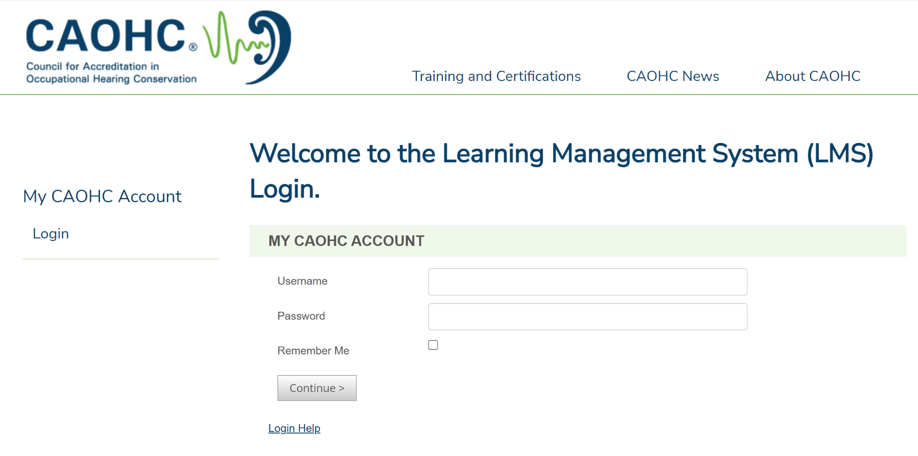
CLC – Student Login

Slide 6
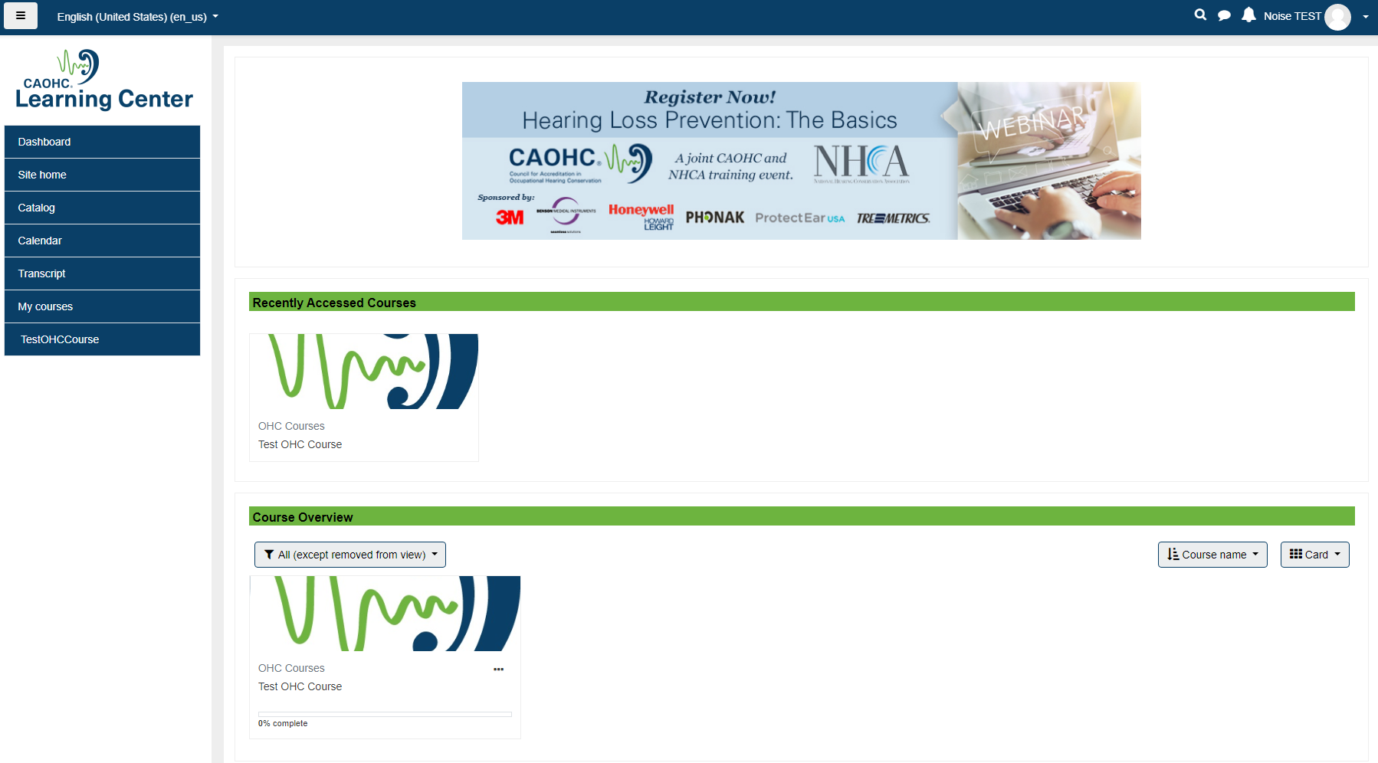
Dashboard

Slide 7
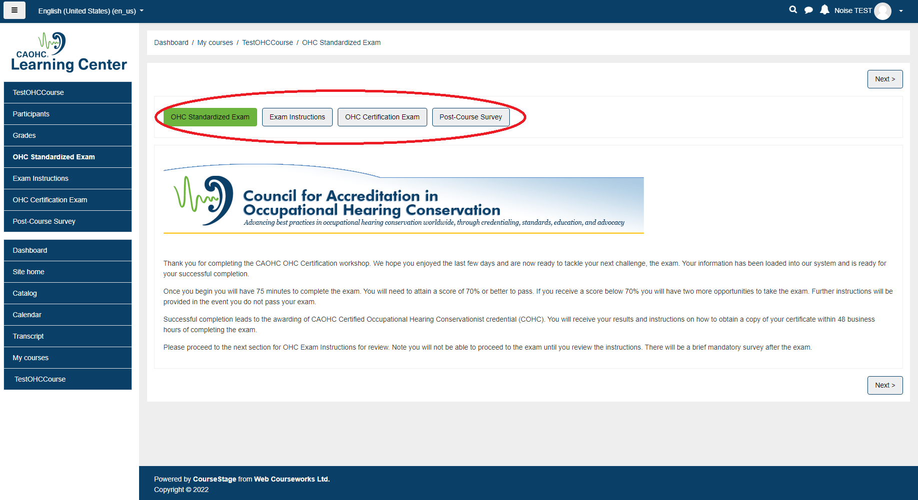
Course Homepage

Slide 8
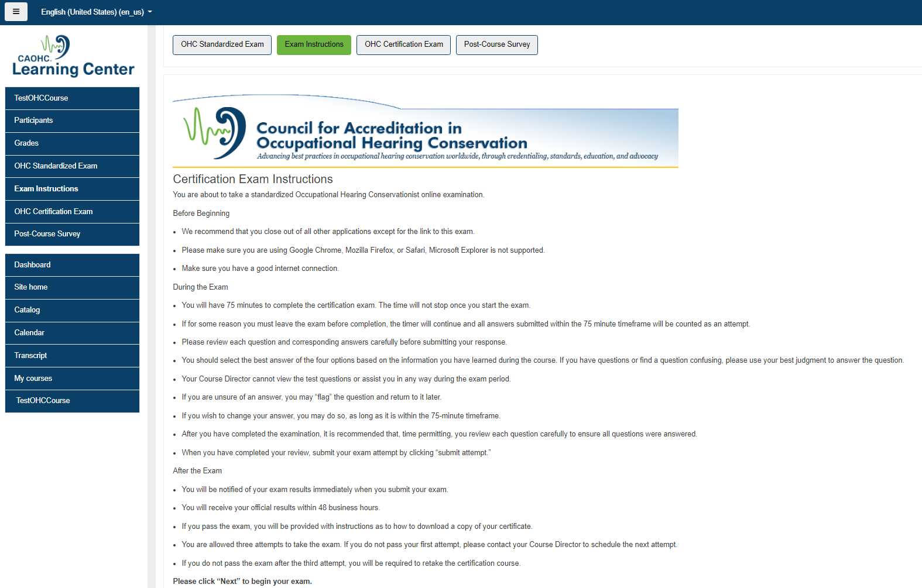
Initial Cert Exam Instructions

Slide 9
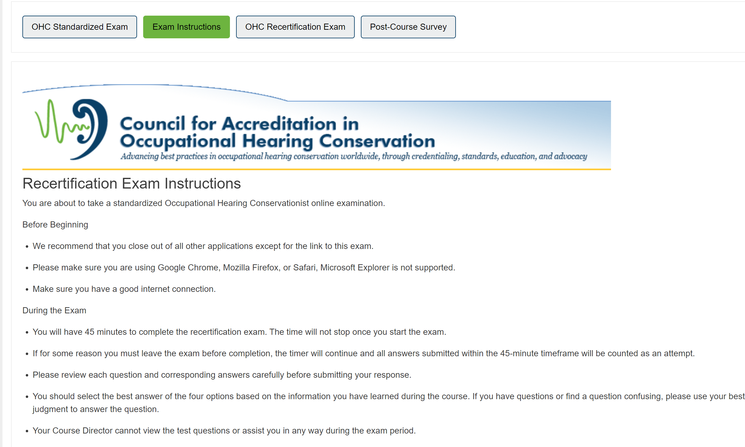
Re-Cert Exam Instructions

Slide 10
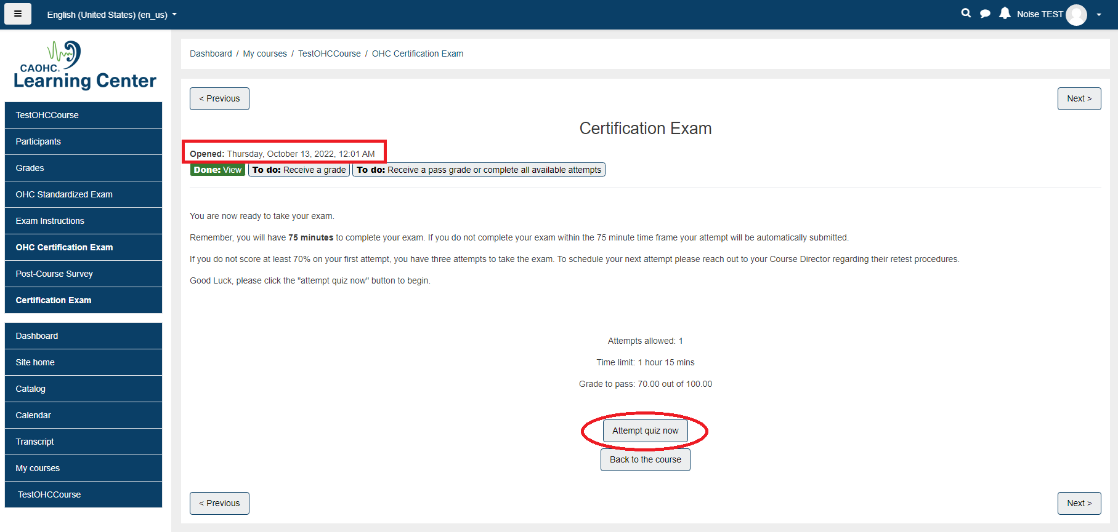
Exam Page – Start Attempt

Slide 11
Exam Question Screen
Time Clock
Flag questions to go back
for later review

Slide 12
Exam Question Screen
Review any flagged questions
and then finish attempt
Or

Slide 13
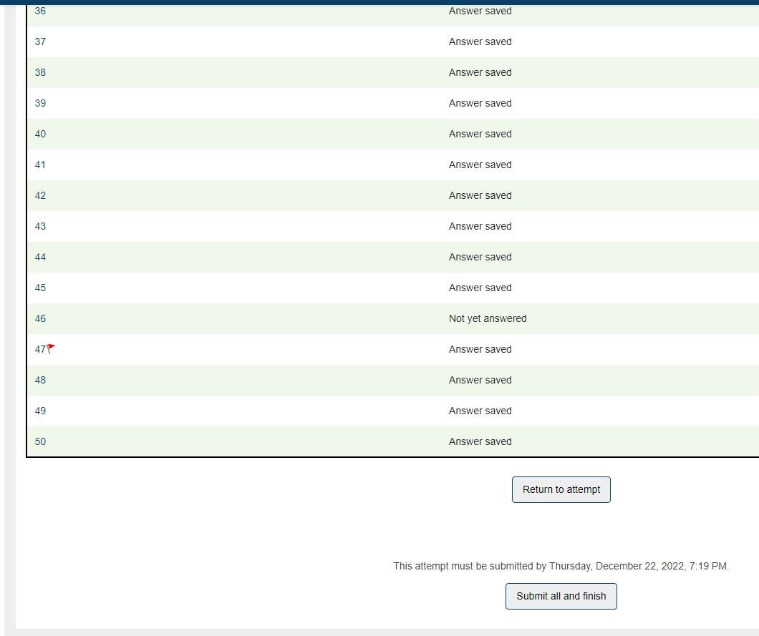
Exam Submission
Check for
“Answer Saved”
for all questions
BEFORE
submitting exam
Confirm Submission

Slide 14
Exam Results

Slide 15
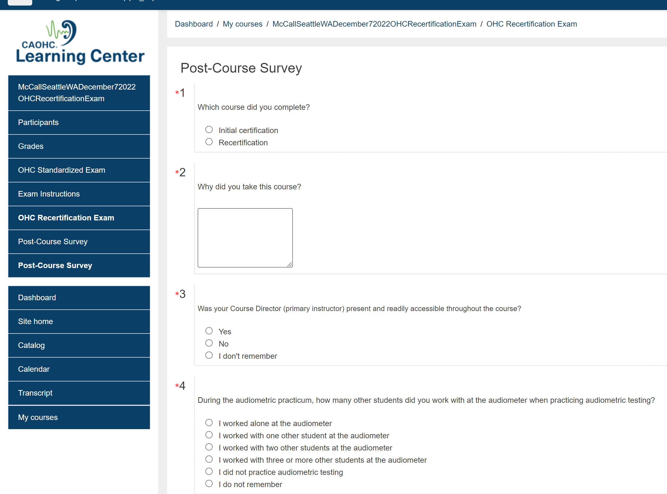

Slide 19
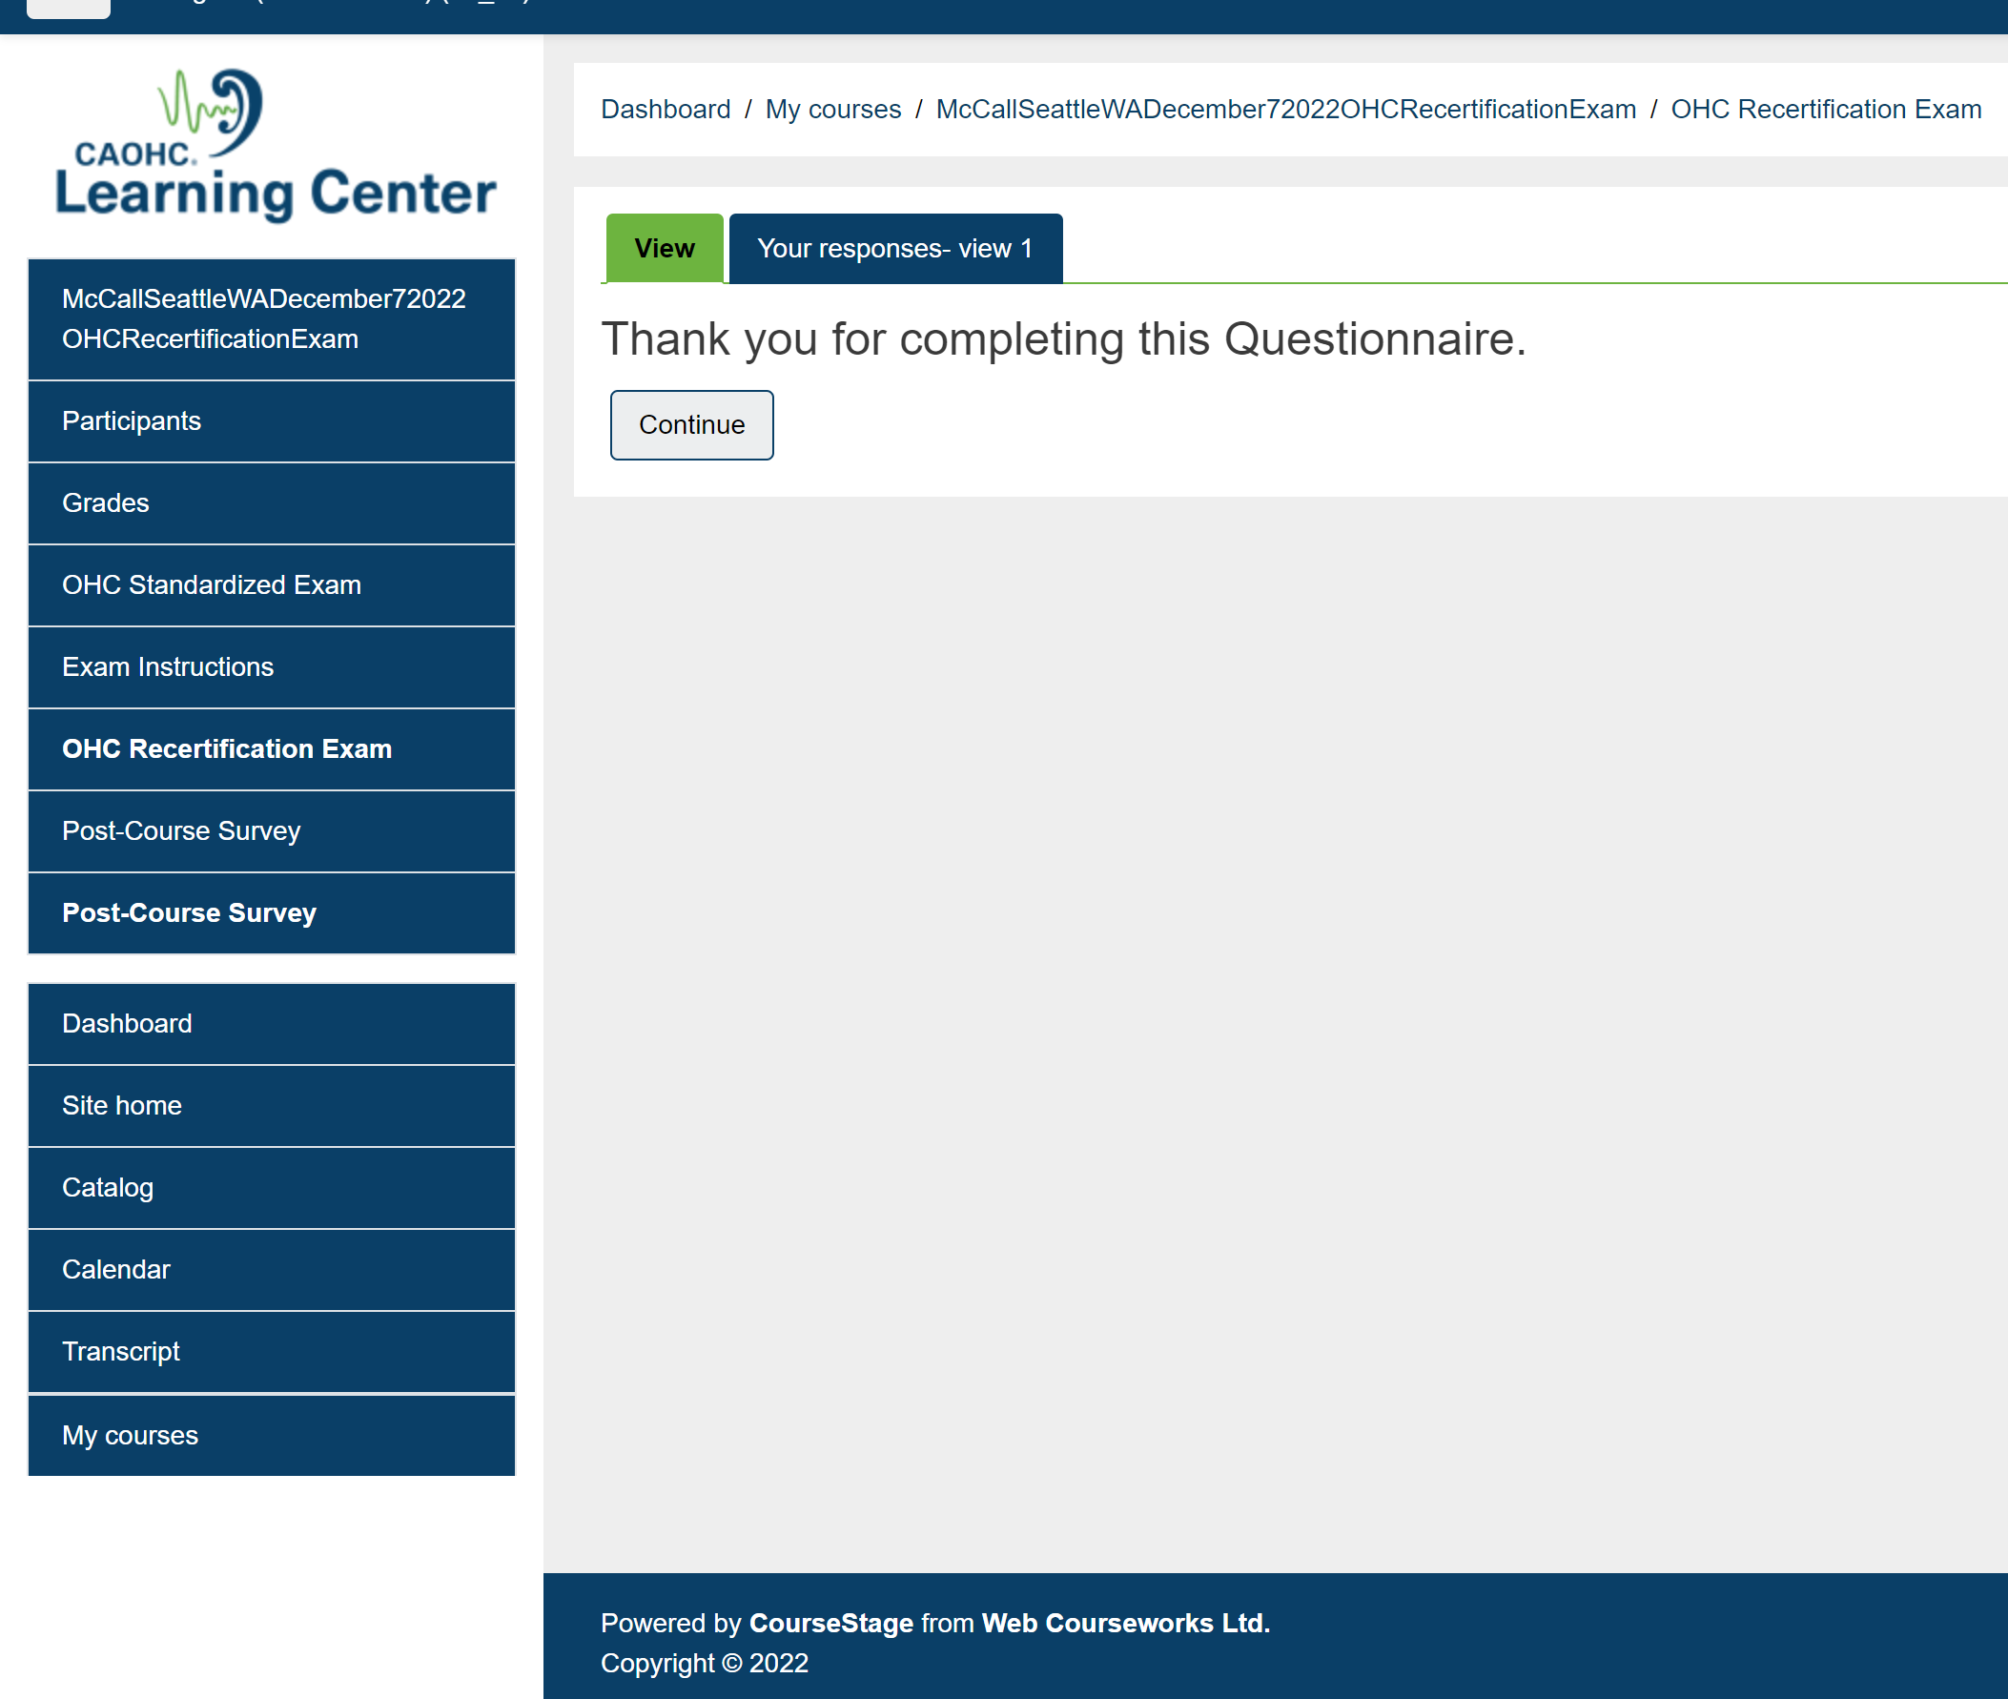
You may now log out

Slide 20
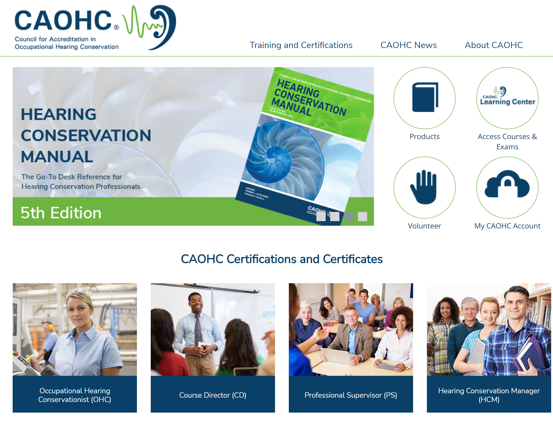
Print / Download OHC Certificate Available 1-2 hours after submitting exam

Slide 21
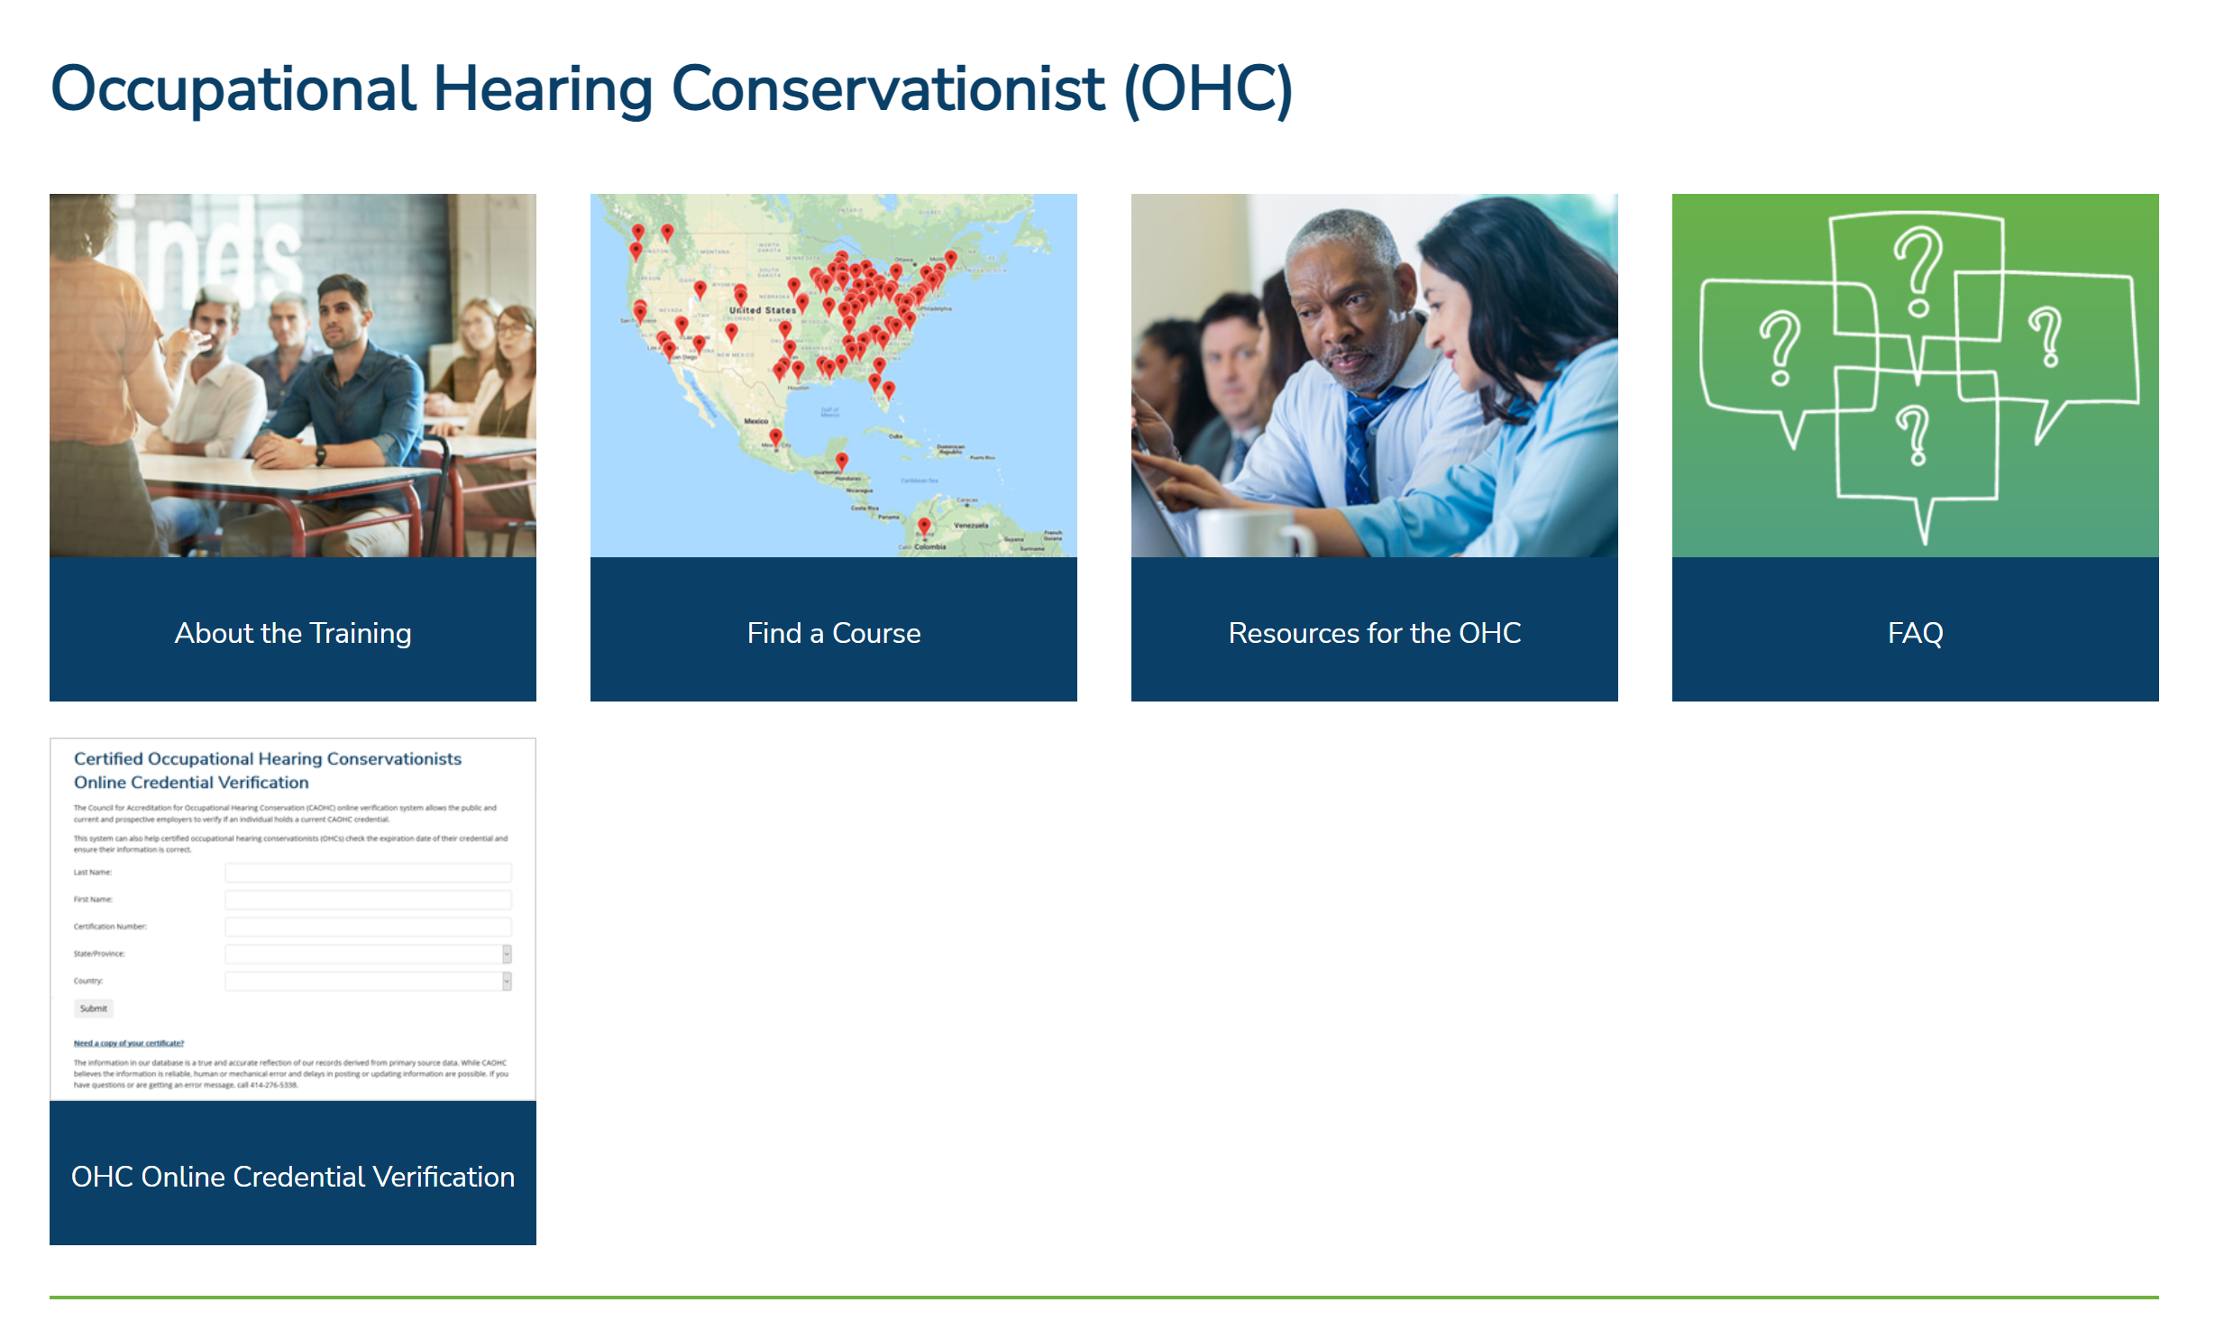
Print / Download OHC Certificate

